Slide 1

Sage 300 Standards & Patterns Code Reviews
John Thomas (JT)
Principal Software Architect
April 2023
Notes:
Welcome to the Coding Standards, Patterns and Code Reviews session for the Sage 300 application.
I am John Thomas, also known as JT, and I’m the Architect on the Sage 300 product.
Let’s get started.

Slide 2
Table of contents
Improbability Principal
David Hand
Code Reviews
Deep Dive
Coding Standards
Excellence is a Habit
Coding Pattens
Consistency
Notes:
In this session, we will dive into the Improbability Principle by David Hand, a drill down on why it is important to do it right the first time, coding standards, coding patterns, why code reviews are so important, code reviews and the use of ReSharper.
And questions, suggestions and feedback are valuable. So, please let your voice be heard!

Slide 3
Improbability Principal
David Hand

Slide 4

Improbability Principal
David Hand
We think something is incredibly unlikely, when it is actually very likely, perhaps almost certain
Web Screens
Think vertically and horizontally
Keep your head up
Always keep in my “what if …”
We should not be surprised by coincidences
We should expect an event to happen, no matter how unlikely
Where does reality meet improbability?
Defensive programming
Notes:
The Improbability Principle by David Hand states that we think something is incredibly unlikely, when it is actually very likely, perhaps almost certain. So, how does this apply to software development?
Good defensive development skills teach you to code for events that will happen, might happen and even for those that “will never happen”. We need to consider all cases when implementing a solution.
Thinking horizontally means how a solution will affect other areas of the application and not just the current issue being solved for. This means keep your head up and consider the application as a whole as it relates to what is being implemented.
Not all “what if” scenarios need to be coded for, but they do need to be considered! And when does reality meet improbability? It is subjective, but with input from mentors, SMEs (subject matter experts) and experience with the application and code base, the requirement to implement code for improbable scenarios will gain clarity.
It starts with defensive programming and ends with defensive programming.

Slide 5
Coding Standards
Excellence is a Habit

Slide 6
Coding Standards
Excellence is a habit, not an act
Web Screens
“We are what we repeatedly do. Excellence, then, is not an act, but a habit.”
-Aristotle
How to do things right instead of doing things over?
How do we have time to do something over, but not enough time the first time?
What are the repercussions for not doing it right the first time?
Excellence Breeds Excellence
“If you fail to plan, you are planning to fail.”
-Ben Franklin
“A goal without a plan is just a dream.”
-Unknown
Notes:
As Aristotle noted, excellence is a habit and not an act. It is something that must be worked at.
Always consider the best possible solution first, not the quickest solution first. That’s how you can do things right instead of doing things over.
By failing to plan, we give ourselves the time to do something over, but do not give ourselves enough time to begin with.
Bad customer experience, bad press, and doing whatever over to get it right are the outcomes of not doing it right the first time.

Slide 7
Coding Standards
Failure Demand
Failure demand is a systems concept used in service organizations first discovered and articulated by Professor John Seddon as ‘demand caused by a failure to do something or do something right for the customer’.
-Wikipedia
Web Screens
Increased costs
More work in the long run
Affects customer satisfaction
Overall
Loyalty
Cognitive
Behavior
“You can pay me now or pay me later.”
-FRAM Oil Filters
“Laziness means more work in the long run.”
-CS Lewis
Notes:
I love the quote from CS Lewis!
Not doing it right the first time, whether that be with a tweak or a re-factor or a re-write, it will lead to increased costs.
Not doing it right the first time, whether that be with re-acquiring domain knowledge or scheduling, will require more work in the long run. How much time and effort is it going to take to re-investigate something? This can be very costly and frustrating.
Not doing it right the first time will affect customer satisfaction. There are different aspects of customer satisfaction:
Overall – We want “I’m glad I’m using Sage 300 and not I wish I was not using Sage 300”
Loyalty – We want “I’m going to stick with Sage 300 and not I want to replace this Sage 300 solution”
Cognitive – We want “Sage 300 satisfies my needs and not I’m not satisfied with Sage 300”
Behavior – We want “The Sage 300 release is great and not this Sage 300 release stinks”

Slide 8

Coding Standards
Let’s Start Now!
Web Screens
SWAGs are important
Doing it right the first time
Let’s spend time now and not later
Each screen needs to be a showcase
Each project needs to be a showcase
Each developer needs to be proud of their work
Eyes on the prize!
Notes:
Doing things right. Let’s start now!
SWAGs are important as they help to not underestimate or overestimate a project. We need to learn from previous SWAGs, analyze how close to the SWAG the real cost was and refine our SWAGs based upon this analysis.
It is cheaper is the long run to spend the time up front. While circumstances may not let us always develop this way, this is the mindset we need to strive for.
When writing some code, let it be a showcase to other developers. Be proud and not boastful of your work. We have third party developers that get to see our code!
It’s a mindset to do it right and it’s everyone's responsibility too!

Slide 9
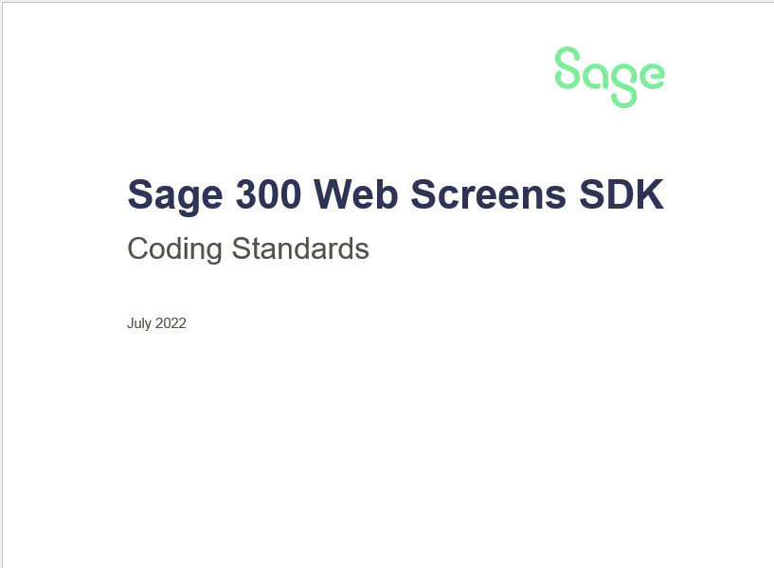
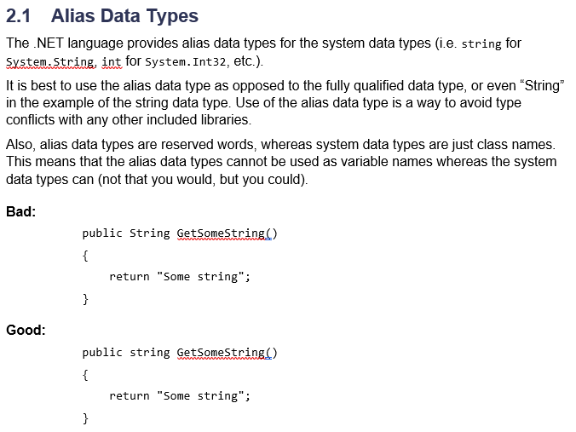
Coding Standards
Documents
https://github.com/SageNADev/Sage300-SDK/tree/develop/docs/standards
Web Screens
Notes:
In the Sage 300 Web SDK, you will find the Sage 300 Web Screens SDK Coding Standards document.
Any new standards or standards that are to be revised are documented here.
A standard is not a standard until it is documented!!

Slide 10

Coding Standards
Summary
Web Screens
Subjective until agreed upon
Objective once agreed upon
You don’t have to like them
You do have to follow them
All-In-One Code Framework Coding Standards
Static document
Sage 300 SDK Coding Standards
Living Document
Notes:
The docs/standards folder of the Sage 300 Web SDK contains standards documents that are a required reading before any development begins.
The All-In-One Code Framework Coding Standards Word document contains standards from a Microsoft perspective. These are the basis for the standards of the web screens and are to be adopted and strictly followed. This is a static document.
The Sage300SDK_CodingStandards Word document is the Sage 300 supplement to the Microsoft document. The standards in the Sage 300 document may supplement or override the Microsoft standards. Be familiar with these standards as they are the basis for quality code and for code reviews. This folder also contains an HTML and CSS Guide for the web screens, which explains and illustrates the standards to be followed in the Razor Views and Stylesheets.
Standards are meant to be followed, but they can also be challenged. Paradigm shifts take place all of the time in software development. And, standards have to evolve and potentially widen as well. If a new standard or better standard exists, bring this to the Architect and begin a discussion. Standards are the “sandbox” in which internal and external developer are expected to “play” in. If an existing standard has become obsolete, determined to be faulty or a better standard exists, let’s review it, discuss if it can replace or augment the existing standard, and then get it into the Standards document. Being a rebel is playing outside the sandbox. Widening the sandbox with new standards or better standards is smart and dynamic development.
Code reviews are based upon standards and patterns. They are expected to be followed. You could place 5 developers in a room and have potentially 5 different views on a single standard being discussed. This is healthy and normal as it is at times a very subjective process of determining what should and what should not be a standard. But, once the standard is agreed upon (probably not by unanimous consent), it becomes objective. And, regardless whether for or against a particular standard, the expectation is that it will be followed.

Slide 11
Coding Patterns
Consistency

Slide 12

Coding Patterns
Questions to Ponder
Web Screens
What is consistency?
What is a pattern?
Why follow patterns?
How to think in patterns?
What to do when multiple patterns exist?
Where to document a pattern?
How to get a pattern approved?
Notes:
Let’s answer some of these questions as we ponder coding patterns.

Slide 13
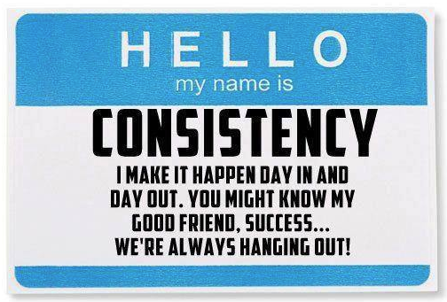
Coding Patterns
What is consistency?
Conformity in the application of something, typically that which is necessary for the sake of logic.
-dictionary.com
Web Screens
Logically ordered and/or following the same pattern.
-businessdictionary.com
Let’s be consistently right or consistency wrong. But let’s be consistent.
-JT
Notes:
Consistency, when talking about coding patterns, is important when it comes to conformity in the application. The first two patterns really address what consistency means to a software application. The third, well, is my addition to the definitions.
If we are consistently right, we are creating excellent patterns, using them and not deviating from them. If we use wrong patterns consistently, at least we can readily fix these because we are consistent in that approach. Where it gets murky is where we are inconsistent in our patterns or approach. We then have to research and analyze what is right and what is wrong. This is time consuming and counter-productive.
The best approach to our use of patterns is to not deviate from the accepted patterns and implement them as required.

Slide 14
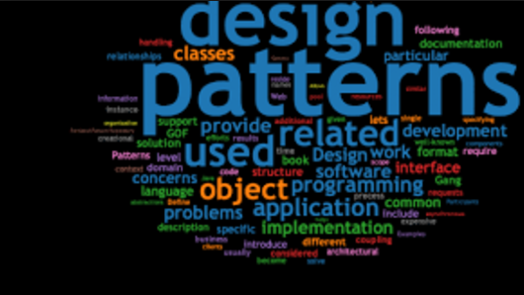
Coding Patterns
What is a pattern?
Consistent and recurring characteristic or trait that helps in the identification of a phenomenon, and serves as an indicator or model for predicting its future behavior
-businessdictionary.com
An attempt to capture the best practice in a domain and transfer that knowledge to other practitioners
Expresses the tried and proven within a given domain
-Joseph Bergin
Describes a problem which occurs over and over again and then describes the core of the solution to that problem, in such a way that you can use this solution a million times over, without ever doing it the same way twice
-Christopher Alexander
Web Screens
Notes:
These are the definitions for what a pattern is when it comes to software.
They are consistent as defined in the previous slide. They are best in practice and are for the benefit of the entire team, not just the application. They are tried and true meaning that they have been reviewed, accepted and implemented. They solve for something that occurs over and over again in an encapsulated and reusable format.
Patterns are important to every software application and are especially true for Sage 300 where we have both internal and external developers.

Slide 15
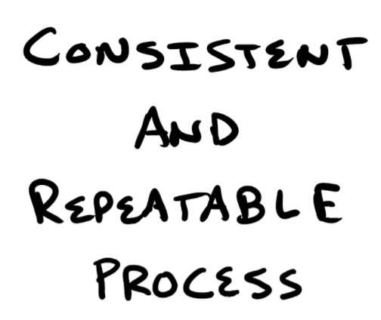
Coding Patterns
Why follow patterns?
Web Screens
Develop software that makes sense
Have components that are reusable
Reduce defects with common functionality
Reduce recurring issues
Smaller code base
Notes:
Why follow patterns? There is that word consistency again!
As stated in the previous slide, we have both internal and external developers. Patterns allow us to develop software that makes sense for both types of developers. The application is intended to be around for awhile and therefore it makes sense to have the application based upon a code base that is solid, robust and consistent.
Solving a problem more than once is probably the definition of insanity when it comes to software development. Also, multiple patterns that solve the same thing have to be maintained separately and may contain “different” logic. It gets fixed in one area, but the other area may still have an issue. A single, encapsulated pattern does not present this issue. Fix it once and it is fixed.
When it comes to an application the size of Sage 300, a smaller code base means less of an area for things to go wrong.

Slide 16

Coding Patterns
How to think in patterns?
Web Screens
Be born that way or put in the effort
Be observant and think horizontally
Recognize, recognize, recognize
Think, think, think
Patterns are not seen in decisions, but the shadows they create
Two or more decisions casts the same shadow. A pattern!
Patterns are detected in echoes
Different actions, same echo. A pattern!
Notes:
All developers think in patterns or else you would not be in this field or in the job of a developer!
But patterns come easier to some than they do to others. For these developers, it will be a matter of training your brain to think in patterns and you do this by being observant, and by lifting your head when solving an issue and considering if this is a pattern that already exists or should exist in a pattern that can be used by others.
Always consider patterns and always think in patterns.

Slide 17

Coding Patterns
What to do when multiple patterns exist?
Web Screens
We need to discuss it
Understand the different implementations
Determine the better pattern
Address now or add to tech debt
Document, document, document
Be part of the solution, not ongoing debt
It’s everyone’s responsibility
Notes:
Sage 300 is not perfect and we have as many weeds in our grass as others. So, multiple patterns may have been introduced that either solve for the same issue or we have faulty patterns.
The first thing we need to do when multiple patterns are detected is to discuss it, not to ignore it. Ignoring the issue only delays it for another day or to be reported by external developers.
We need to understand not only why there are multiple implementations, but to also understand these different patterns. What does one do that the other does not? Does they both solve for the same, but do it differently? If so, which one is better?
Once we have answered these questions, we can tackle as to when it should be addressed? Do we do it now or add it to our Tech Debt to be addressed later? There are numerous reasons why both appropriate – capacity, risk, timing, severity, small window of opportunity, etc.
We all are responsible for the quality, reliability and stability of the code. We can only do this by being aware of how multiple patterns, bad patterns and redundant code make all of jobs harder in the long run. It is not only a race to the finish line (a sprint), but also a long race (we are in this for the haul).

Slide 18
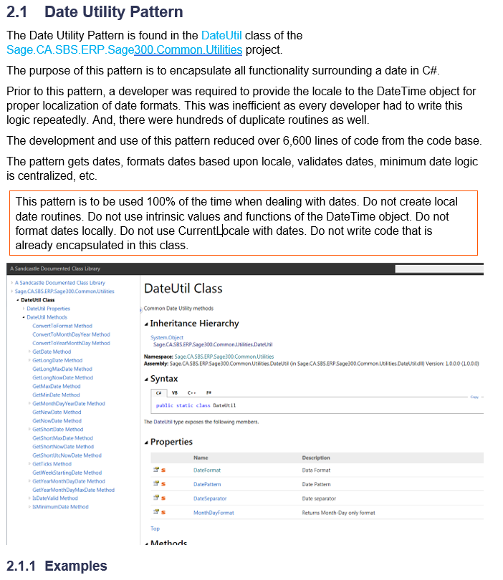

Coding Patterns
Where to document pattern?
Web Screens
Living document
Accepted patterns
Description
Rationale
Examples
Both Internal and External Developers need these patterns
Notes:
Sage 300 is not perfect and we have as many weeds in our grass as others. So, multiple patterns may have been introduced that either solve for the same issue or we have faulty patterns.
The first thing we need to do when multiple patterns are detected is to discuss it, not to ignore it. Ignoring the issue only delays it for another day or to be reported by external developers.
We need to understand not only why there are multiple implementations, but to also understand these different patterns. What does one do that the other does not? Does they both solve for the same, but do it differently? If so, which one is better?
Once we have answered these questions, we can tackle as to when it should be addressed? Do we do it now or add it to our Tech Debt to be addressed later? There are numerous reasons why both appropriate – capacity, risk, timing, severity, small window of opportunity, etc.
We all are responsible for the quality, reliability and stability of the code. We can only do this by being aware of how multiple patterns, bad patterns and redundant code make all of jobs harder in the long run. It is not only a race to the finish line (a sprint), but also a long race (we are in this for the haul).

Slide 19
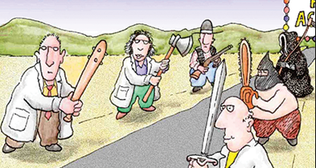
Coding Patterns
How to get a pattern approved?
Web Screens
Is it or will it be used in multiple locations?
Does it meet all the coding standards?
Has it been code reviewed and peer reviewed?
Architectural review and acceptance
Added to Coding Patterns document
Easy!
It is every developer’s responsibility to document patterns
Notes:
It is not a scary or intimidating process. But it is a process that must be reviewed and address some base questions before it is used by whomever needs it throughout the application:
Will it be used in multiple locations? If not, it will simply be code reviewed as part of the doneness criteria as it will not impact others.
Has it met all of the coding standards? It must be tight, meets all of the standards and is solid before it can and should be used in multiple locations
Has it been code reviewed and peer reviewed? This is important as others may have insight as it why it can not be used in multiple locations or multiple scenarios. No silo development!
It will be reviewed from an architectural perspective and documented. Easy! The documentation part is everyone’s responsibility and not only assists internal developers but is crucial to external developers. Document. Document. Document.

Slide 20
Code Reviews
Deep Dive

Slide 21
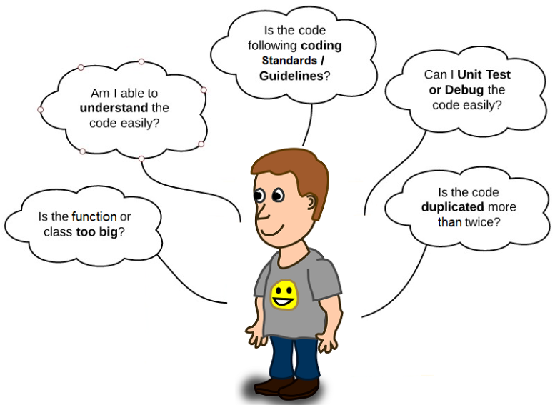
Code Reviews
What is a code review?
Web Screens
Code reviews help developers learn the code base as well as help them learn new technologies and techniques that grow their skill sets!
Notes:
A code review is systematic examination (sometimes referred to as peer review) of computer source code. It is intended to find mistakes overlooked in software development, improving the overall quality of software.
Code reviews are important for several reasons that we will discuss.

Slide 22

Code Reviews
What a code review is not!
Web Screens
Code reviews are meant to be positive, not negative or intimidating!
Notes:
Code reviews help ensure developers are “paying attention to the details” and are positive.
They are not meant to intimidate, be negative or even assign a status to a developer. Sure, there will be findings, but these findings are not meant to identify or stereotype a developer.
Repeat findings are a way to identify needed improvement and maybe more attention to detail.

Slide 23

Code Reviews
The agile impact
Web Screens
Code reviews help facilitate knowledge across the code base and across the team!
Notes:
The Sage 300 development team follows the Agile Methodology for software development. In this methodology, team members may work on different items within a team and even for different teams.
Therefore, code reviews are a great way to facilitate knowledge across the team and teams within the development group.
Allowing multiple developers to understand the code base is a great learning tool provided by code reviews. You are not just understanding a snippet here and there, but flow and process logic as it relates to the application as a whole.

Slide 24

Code Reviews
The estimating impact
Web Screens
Estimating is a team exercise, and the team can make better estimates as product knowledge is spread across the team!
Notes:
Another benefit of code reviews is in the area of estimating. As more developers are familiar with the code base, the joint exercise of performing estimates, SWAGs, can result in more quality estimates made possible by more folks familiar with the requirements and code.
Since team members can be shared across multiple SCRUM teams, this knowledge can be spread to all teams.
Better estimates result in happier management as capacities are planned and expectations met.

Slide 25

Code Reviews
The time-off Impact
Web Screens
Code reviews share knowledge across the team to minimize a single developer from being the critical path!
Notes:
Nothing is worse than being critical path, especially when you need to take a day off or a vacation or just simply get sick.
Since knowledge is being shared and consumed during the code review process, it minimizes not reduces the critical path issue. It minimizes the effect of having time off as other developers should be able to step in and assist where needed. This is not always ideal as there is probably ramp-up time, learning and other issues that have to be dealt with.
But code reviews can be beneficial in this area.

Slide 26

Code Reviews
The mentoring Impact
Web Screens
New team members are mentored by veteran team members!
Code reviews help facilitate conversations about the code base.
Notes:
Code reviews are a great place for mentoring.
Senior developers or even developers familiar with the code can not only assist new team members in getting up to speed on the standards and patterns, but the code reviewers can also learn more about the code base and code implementations.
This also can be a great place to have conversations about the code:
Why did you do it this way?
Huh, I did not know you could do that!
I like what you did, but have you tried this…
Etc.
The developer having their code reviewed and the developer performing the code review are in a great position to help one another out and come out of the process with a better understanding of the code base and application.

Slide 27

Code Reviews
Never a waste of time!
Web Screens
Code reviews take time, but they are NOT a waste of time!
Notes:
Sure, code reviews take time unless it is only a one or 2 line code change. But, they are not a waste of time.
You will get out of them what you put into them. If you do not spend the time to consider why a developer is making the change the made, or how it will impact other modules and screens, or if the change introduced a new pattern or standard, or if existing standards and patterns were followed, then it might be a waste of time. But, the lack of time is a dis-service to the developer and code reviewer.
It is a standard to perform code reviews. They are as important as the code change itself.

Slide 28
Code Reviews
If you find a defect…
Web Screens
Fix It!
Or
Write it up!
Or
Tell someone about it!
But,
Do not ignore it!
Notes:
During the code review process, it is not uncommon to determine that another bug or defect exists either within the code being reviewed or on the periphery.
Once discovered, a bug or defect needs to either be fixed or written up, but it should never be ignored.
The defect can be returned to the developer to be addressed or written up as a defect by either the developer or the code reviewer. Usually, capacity, risk, severity, and input from the Scrum Master, PO and Architect can help make the decision on how to address.

Slide 29
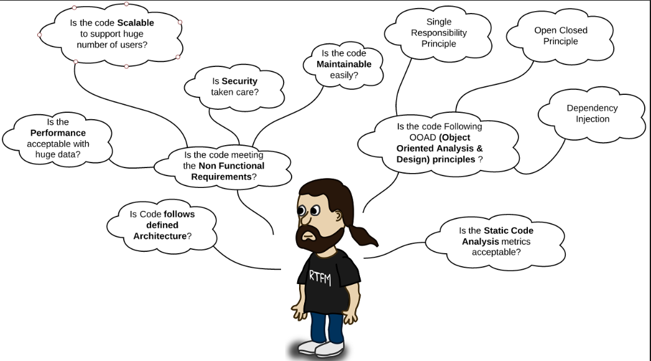
Code Reviews
What is a code review?
Web Screens
Let’s really dig into our code and ask the hard questions!
Notes:
As seen in the first slide on code reviews, a code reviewer can look for the expected items: coding standards, coding patterns, addresses issue at hand, etc.
But, the expert code reviewer will ask the hard questions as he or she looks at Performance, Scalability, Security, Maintainability, OOP, Dependency Injection, etc.
We can become better developers by asking these hard questions, by making sure that we address these in our code to be reviewed, by learning from others and by mentoring and teaching others.

Slide 30
Code Reviews
Whose responsibility, is it?
Web Screens
It is everyone’s responsibility!
Notes:
It’s every developer’s and code reviewer’s responsibility.
Do not assume that a code reviewer will catch your mistakes and issues. That is what they will do, but that is not their job. Their job is to ensure that you are delivering great, quality code.
Do not assume that a developer will deliver great code just because of their seniority or status. Everyone makes mistakes as we all are human.
Mistakes will happen and therefore the code reviewer is in a great position to catch these.
The developer should strive for nothing to be found by the code reviewer. The code reviewer should strive to find something. Going through the motion is a waste of time. Make the time spent count!

Slide 31
Code Reviews
Standards and patterns
Web Screens
Review and follow the standards!
We are not to pick and choose which standards we want to follow!
Notes:
Developers need to understand the standards and patterns to follow. It is equally important for code reviewers to understand these same standards and patterns.
Remember that once a standard or pattern is documented, regardless of our individual preferences, a standard or pattern is meant to be followed. We are not allowed to pick and choose what we want or do not want to adopt.
In the near future, we will look at additional Visual Studio tools to assist with automating standards and, potentially, patterns.

Slide 32

Code Reviews
Quality code
Web Screens
“Standards are the footprints on the path we hope we’re brave enough to take.”
-Bridgette Bassa
We can do it!
We must hold ourselves to the same level of quality that we expect from others!
Notes:
Quality first and foremost starts with the developer. It is re-enforced by the code reviewer and code review process.
We can do this!

Slide 33
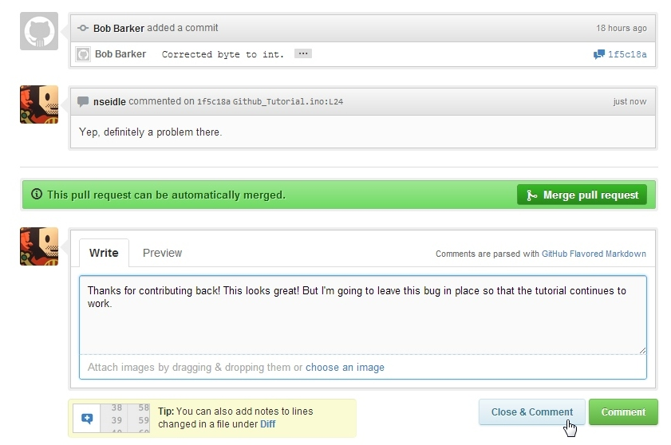
Code Reviews
GitHub
Web Screens
Propose Changes
Request Reviews
See the Difference
Comment in Context
Give Clear Feedback
Protect the Branches
GitHub Code Review Procedures
Columbus-Documentation/Code Review/GitHubCodeReviews.docx
Notes:
For internal developers, we use GitHub’s Code Review mechanism to perform code reviews on the Sage 300 Web Code. The Sage 300 Desktop does not use GitHub.
Propose Changes
Better code starts with a Pull Request, a living conversation about changes where you can talk through ideas, assign tasks, discuss details, and conduct reviews.
Request Reviews
If you’re on the other side of a review, you can request reviews from your peers to get the exact feedback you need.
See the Difference
Reviews happen faster when you know exactly what’s changed. Diffs compare versions of your source code side by side, highlighting the parts that are new, edited, or deleted.
Comment in Context
Discussions happen in comment threads, right within your code. Bundle comments into one review, or reply to someone else’s inline to start a conversation.
Give Clear Feedback
Your teammates shouldn’t have to think too hard about what a thumbs up emoji means. Specify whether your comments are required changes or just a few suggestions.
Protect Branches
Only merge the highest quality code. You can configure repositories to require status checks, reducing both human error and administrative overhead.
In the Columbus-Documentation repository are a two documents. The first document explains and illustrates the code review procedures when using GitHub. The second document is an Excel spreadsheet that has checklist items for the code review process. The Excel spreadsheet was used in the past when working with Sonata as a tool that was used to review the code and then was attached to a Version One story. This checklist is no longer used in this fashion, but the contents are still valid.

Slide 34
Thank you!

